Slide 1
Aboriginal Relationship and Cultural Competency (ARCC) Courses
Insert Date

Slide 2
The Truth and Reconciliation
A total of 7 calls to action were made by the TRC to improve the health and well-being of Aboriginal people, including a recommendation calling upon all levels of government to provide cultural competency training for all health care professionals.
Notes:
The Truth and Reconciliation Commission (TRC) released its final report in December 2015, detailing the findings from extensive public hearings, of what happened to Indigenous children in government boarding schools.
The 94 calls to action urge all levels of government to work together to change policies and programs in a concerted effort to repair the harm caused by residential schools and to move forward with reconciliation.
A total of 7 calls to action were made by the TRC to improve the health and well-being of Aboriginal people, including a recommendation calling upon all levels of government to provide cultural competency training for all health care professionals.

Slide 3
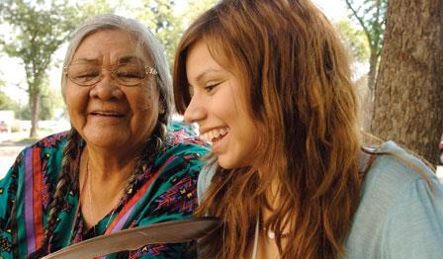
Health Equity
First Nations, Inuit and Métis patients and families who experience culturally safe health care are more likely to:
access care earlier,
feel more at ease and empowered throughout the process of receiving care,
share details about their health concerns and care preferences,
return for follow up visits,
follow treatment plans recommended by health care providers.
Notes:
However, this is not the only reason that cultural competency is important.
We know that First Nations, Inuit and Métis (FNIM) peoples bear a disproportionately high cancer burden, and face greater health disparities, barriers and gaps to health services when compared to the general population of Ontario.
One specific barrier to receiving equitable cancer care, faced by FNIM people, is a lack of cultural safety and competency within the cancer system.
FNIM patients and families who experience culturally safe health care are more likely to access care earlier, feel more at ease and empowered throughout the process of receiving care, share details about their health concerns and care preferences, return for follow up visits and follow treatment plans recommended by health care providers.

Slide 4
ARCC Courses
Overview
13 online courses will provide you with knowledge about the history and culture of First Nations, Inuit and Métis people and communities.
Accredited by the College of Family Physicians of Canada and the Ontario Chapter for up to 19.5 Mainpro + credits.
Designed for self-paced learning.
Free!
Notes:
Given this context and environment, Cancer Care Ontario developed Aboriginal Relationship Cultural Competency (ARCC) courses.
13 online courses that ill provide you with knowledge about the history and culture of First Nations, Inuit and Métis people and communities.
Accredited by the College of Family Physicians of Canada and the Ontario Chapter for up to 19.5 Mainpro + credits.
Designed for self-paced learning
Free!

Slide 5
ARCC Contest
For every 2 courses you complete, you can enter into a monthly draw to win a
$100 gift card.
Closes Saturday, June 1, 2019 at 11:59 p.m.
Notes:
Across the Central East Region, we’re holding year long contest to help encourage people to complete these important courses.
Register and access the courses online at elearning.cancercare.on.ca.
After completing each course online you will receive a Certificate of Completion. Don’t forget to save it as a PDF document.
For every 2 courses you complete you can enter into a monthly draw for a $100 gift card.
Your name remains in the draw each month.
The courses are self-paced. So you can take the 13 courses over the year or focus on a course a week. It’s up to you.
But I do encourage you to reflect on the information that you’ve learned.
Previously completed the courses? You’re still eligible to win too!

